Slide 1

OPIM 5604 Project 2
Diabetes Care in U.S. Hospitals: Predicting Early Readmission for Better Outcomes
Vinay Kiran Reddy Chinnakondu
Notes:
Good evening, everyone! I'm excited to welcome you to today's presentation on a topic that holds great significance in healthcare—diabetes care in U.S. hospitals and the proactive approach of predicting early readmission for better outcomes.
Joining forces on this great venture are Vinay, Tom, Mahesh, Puru, Varun, and Xiomara. Our committed team was able to reveal crucial aspects of diabetes care in the United States. With the goal of predicting early readmission of patients.

Slide 2
Agenda
Introduction and Businesses Statement
Data Preprocessing
Partitioning and Oversampling
Modeling
Business Findings
Conclusions
Appendix
Notes:
Our agenda consists of: an introduction of the dataset, the data processing steps we took and why we took them, the models we used, and lastly the business findings and conclusions we came up with.

Slide 3






Introduction to Dataset and Business Problem
Our goal is to optimize diabetes care through data-driven insights.
Our dataset focuses on patients diagnosed with diabetes.
The data spans over a decade – between 1999-2008.
Includes 130 U.S. hospitals.
Despite proven benefits of preventative and therapeutic treatments, hospitals sometimes provide inconsistent care, resulting suboptimal glycemic control. Consequences include:
Increased readmission costs.
Patient complications.
Elevated morbidity or mortality rates.
The dataset contains 101,766 rows and 50 columns.
Each row represents a hospitalized patient diagnosed with diabetes, who underwent lab work, received medications, and stayed up to 14 days.
The dataset includes patient details, admission information, physician specialties, lab tests, HbA1c results, diagnosis, medication history, and outpatient, inpatient, and emergency visits in the year prior to hospitalization.
The objective is to assess early readmission within 30 days of discharge.
This can reveal issues in diabetes management.
Notes:
Our dataset centers on individuals diagnosed with diabetes, covering a time span from 1999 to 2008 and it includes 130 U.S. hospitals.
Even though we know that taking preventive and therapeutic actions can be really helpful, sometimes the care provided in hospitals isn't consistent. This inconsistency can make it hard to control blood sugar levels effectively. The result? Higher costs for returning to the hospital, more problems for patients, and an increased chance of serious illness or even death.
This data set is comprised of a hundred and one thousand seven hundred sixty six rows and 50 columns, it captures a wide range of patient scenarios. Each row corresponds to a hospitalized patient diagnosed with diabetes, having undergone lab work, received medications, and experienced stays of up to 14 days.
The dataset offers a comprehensive view of the patient's healthcare journey. Patient details, admission information, physician specialties, lab test results, HbA1c data, diagnosis, medication history, and records of outpatient, inpatient, and emergency visits in the year preceding hospitalization.
Our primary objective is to evaluate early readmission within 30 days of discharge, a metric that can reveal crucial insights of the complexities of diabetes management.

Slide 4
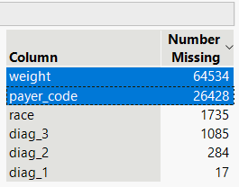
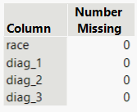
Data Preprocessing
“readmitted” was converted to a binary target to enhance precision.
The target variable in our dataset is “readmitted.”
“readmitted” is a categorical variable with a value of ”NO,” “<30,” or “>30.”
The dataset was modified to eliminate all rows with readmission after 30 days, i.e., “>30.”
Goal is to reduce complexity and make “readmitted” binary, i.e., yes or no.
Readmission within 30 days is a bigger concern rather than after 30 days.
The number of rows were reduced to 66,221.
Handling missing values
Anomalies (i.e., "?") were converted into missing values.
Another 2 columns were eliminated as there were more than 40% missing values.
An additional 3,121 missing value rows were eliminated using missing values analysis on rows function.
Before Elimination
After Elimination
3,121 missing values
Notes:
To Start off with our Data preprocessing, our target value "Readdmitted" was converted to binary target where initially we eliminated all rows with Readmission after 30 days as Readmission less than 30 days was a bigger concern, and the complexity was reduced to either yes or no through this process reducing total number of rows to 66,221. After that we dealt with the missing values where we eliminated 2 columns where there were more than 40% missing values and another additional 3121 missing value rows were eliminated from 4 columns indicated in the image.

Slide 5
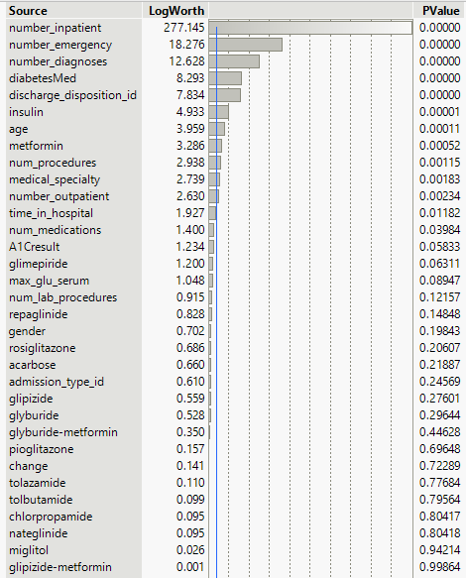
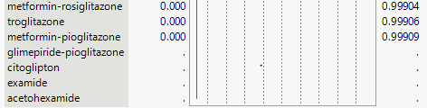
Data Preprocessing
Further refinement of the dataset was done – analyzing and discarding non-essential variables. The result is a set of 16 critical columns for the readmission model – a reduction from the initial 48.
A manual screening of the data to examine the columns and determine variables with good predictive power in real-world.
A few columns seemed significant such as “insulin,” “time_in_hospital,” all admission columns, ”age,” procedures, etc.
Another 8 columns were reduced, i.e., “patient_nbr,” “instance_id,” and few other ID columns.
A basic Fit Y by X model was run to determine which further columns to eliminate.
Columns with a significance less than 90% were eliminated resulting in a reduction of 40 → 16 columns.
The results align with our understandings from manual screening.
All columns with p-value > 10% were eliminated.
Notes:
First we can talk about the time we took to understand the data and all columns manually decide which might be useful and non-useful columns. Took out another 8 columns because those were all different kinds of IDs and not useful for modeling.
Now we can explain we ran a basic logistic model with now remaining 40 columns and selected everything for now with more that 90% significance. It left us with 16 columns to work
Further refinement was done by looking at all the columns manually and eliminating all the non-useful columns such as patient_nbr, encounter_id and other diag_id columns, which reduced another 8 columns. After that we did a basic logistic model to remaining 40 columns where we eliminated all columns with a significance less than 90% and as a result of that we had 16 columns to work with.

Slide 6
Data Preprocessing
To reduce complexity of the model, some categorical columns were grouped and recoded.
“discharge_disposition_id”
“age”
“A1Cresult”
“max_glu_serum”
A
A
B
B
C
C
D
D
Notes:
We performed feature engineering for the highlighted columns because these are useful predictors and had lots of categories. To reduce complexity we grouped and recoded values in these columns which will be explained next in detail.

Slide 7
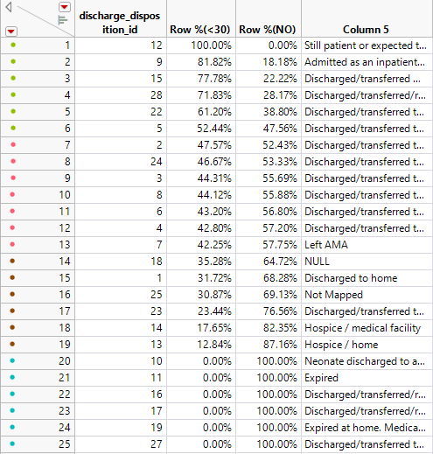
Data Preprocessing
“discharge_disposition_id” was simplified by reducing 25 categories into 4 intuitive groups – improving model precision and targeting key discharge outcomes.
”discharge_disposition_id” approach
Seems to be a continuous variable at first, however every integer is, in fact, a different category.
Reduced 25 different categories down to 4 categories using table on the left which is sorted on descending order on column “<30.”
The 4 new categories are:
Discharged to other facility.
Normal discharged.
Hospice.
Expired/Critical.
A
B
C
A
B
D
C
D
Notes:
As discussed in the previous slide we have 4 categorical columns and discharge disposition id is one of the columns. Initially this column appeared to be a continuous variable by looking at its numerical values. However, upon closer examination, we realized that each number actually corresponds to a specific discharge scenario. To reduce the complexity of the model, we performed data reduction techniques that involved combining the categories into more general groups. We did this by looking the row percentages for each category in relation to our target variable and then grouping those with similar percentages. As we see from category 20 to 25 there is a zero percentage of chance of readmission, so we grouped these categories into single category, in the same manner we grouped the rest of the categories. We experimented with various groupings and, after several trials, concluded that four groups provided the best balance between simplicity and accuracy of the model. Ultimately we were able to narrow down from 25 to just 4 distinct categories.

Slide 8
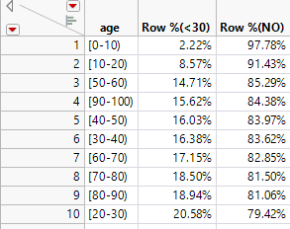
Data Preprocessing
“age” was categorized into four groups to align with risk levels – focusing our model on the most relevant age brackets.
Regrouped several age groups in "age.”
Kids
0-10, and 10-20.
Low Risk
50-60, and 90-100.
Moderate Risk
40-50, 30-40, and 60-70.
High Risk
70-80, 80-90, and 20-30.
A
A
B
B
C
C
D
D
Notes:
For the 'Age' variable, we tabulated the row percentages for each age group against our target outcome, similar to the method applied to the 'discharge_disposition_id' column. We grouped categories based on the percentage of admissions and the associated risk level across different age ranges. Though that higher readmission risks are likely to be for older age groups, our analysis surprisingly suggested individuals aged 20-30 were at the greatest risk of readmission.

Slide 9
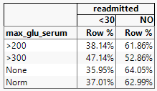
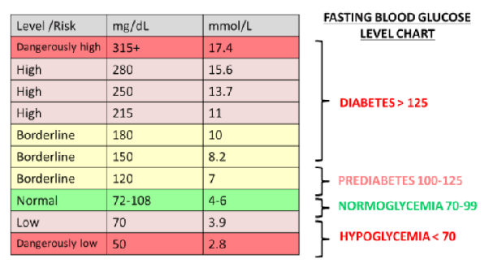
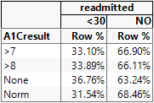
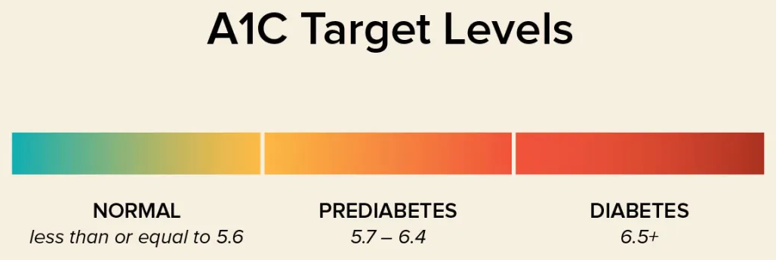
Data Preprocessing
“max_glu_serum” and “A1Cresult” were refined by merging categories – thus simplifying and enhancing the dataset.
Combined “None” and ”Norm” in “max_glu_serum” and renamed to “norm.”
Combined “>7” and “>8” in “A1Cresult” and renamed to “positive.”
Notes:
For max_glu_serum we combined none and norm categories into a single category and named it norm, we can say that >200 and >300 are too far apart with respect to row percentage and it aligns with our research where more than 200 is high but more than 300 is critical. It can be confirmed from table that chance of readmission suddenly increases as glucose level goes past 300.
For A1Cresult we decided to combine both >7 & >8 and renamed it as Positive as they have almost same row% in the target and as per our research a patient is considered diabetic if it’s more than 6.5 and our table narrates the same story as >7 & >8 are pretty close.

Slide 10
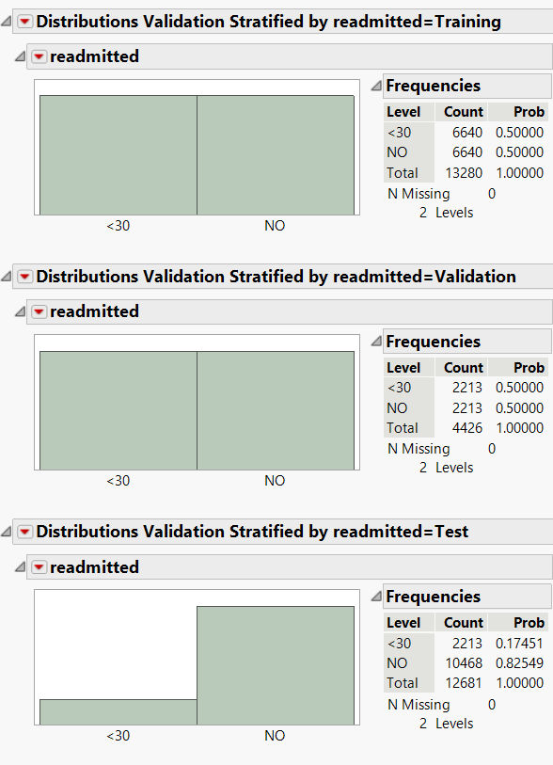
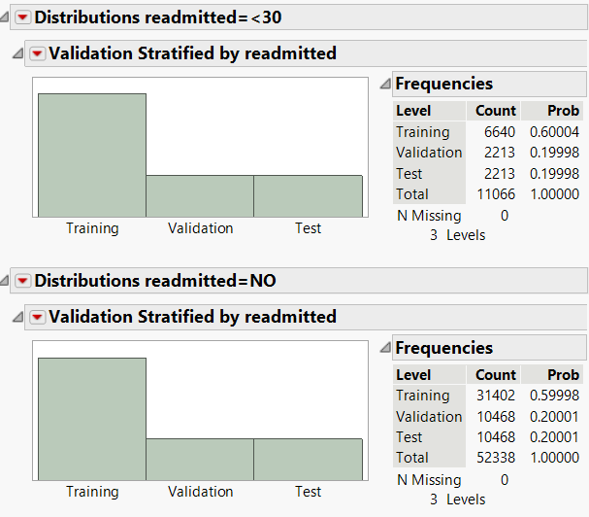
Sampling and Oversampling
Implemented a 60/20/20 data partitioning strategy and applied 50/50 oversampling on training and validation sets to balance the focus on the “<30” day readmission target.
Partitioning
Focused target: 1 (i.e., <30).
Partitioned the data using 60/20/20 rule.
Oversampling
Oversampling on training and validation data by 50/50.
Selected focal group: 1 (i.e., <30).
Oversampling
Partitioning
Notes:
To enhance the training, optimization, and selection of our model, we split our dataset into 60% for training, 20% for validation, and 20% for testing. Given our target variable is categorical and the dataset is imbalanced with 55,000 'NO'’s and 11,000 '>1'. we over-sampling the data to balance the classes equally in the training and validation sets. This aims to improve the model's predictive accuracy for the '>1' category. However, we maintained the true distribution ratio in the test set to accurately assess the model's performance on unmodified data.

Slide 11
Models Used
Evaluated a diverse set of predictive models to identify the most effective approach within 30-day readmission prediction.
Boosted Tree
Bootstrap
KNN
Decision Tree
Logistic
Naive Bayes
Neural
Discriminant
Notes:
Now, we step into the 4th phase of the SEMMA approach i.e. Modeling. All of these models were used in the predictive analysis with an objective to unveil the most effective model by the assessment of their results. These models were developed using training data, tuned by the validation data ,and the best model was determined using the test data.

Slide 12
Costs Associated with Classification Mistakes
Highlights the significant financial and healthcare implications of misclassification in 30-day readmission predictions.
False Positives
$3,500
Basic hospitalization
(per day)
Diagnostic tests
False Negatives
$18,500
Emergency hospitalization
(per day)
$1,000
$2,000
Specialist consultation
$500
Diagnostic tests
$3,000
$3,500
Specialist consultation
$2,000
Treatment for complications
$10,000
False Positives
Can lead to unnecessary medical procedures, treatments, and hospital admissions.
Incurs financial costs and ties up healthcare resources.
False Negatives
May result in missed treatment opportunities, allowing medical conditions to progress without timely intervention.
Can lead to more severe health outcomes and substantially higher healthcare costs.
Notes:
Here, we estimated the costs that are associated with classification mistakes.
As we work through the details of our predictive analysis, it's important to know what false positives and false negatives mean in the real world. Understanding and managing the trade-offs between false positives and false negatives are crucial in optimizing the performance of predictive models and ensuring that the outcomes correspond to their specific goals and objectives of every real-world application.
When we consider FP, they cause unnecessary medical procedures, treatments, and hospital admissions. This not only places a burden on the healthcare system but also pushes people for treatments that might not be necessary which strains both individual & healthcare finances. The anticipated cost for FP is $3,500
Lets’s move on to FN now
In our analysis, we encountered a unique challenge when attempting to assign a cost to false negatives (FN), particularly in a context where FN could signify life-threatening situations. The complexity arises in a way that how do we quantify the cost of a potential loss of life?
To address this, we've made a key assumption that indicates the significance of false negatives in our case. We consider that when we encounter a false negative scenario, we are assuming the patient might be readmitted under critical circumstances and that would result in a higher cost. A tentative cost for this is $18,500.

Slide 13
Model Comparison Across Key Performance Metrics
Comparative analysis of models using key performance metrics, balancing accuracy, sensitivity, and cost to select the most effective model for predicting within 30-day hospital readmissions.
Notes:
To determine the optimal model for predicting 30-day hospital readmissions, we conducted a comparative analysis across key performance metrics. Our focus was not just on accuracy, but rather on a comprehensive assessment that balances precision, sensitivity, and model cost.
If you see the chart carefully, Naïve Bayes, Discriminant and KNN have high model cost which can be eliminated from our assessment. All the other models performs better and similarly across all the parameters.
This is an overview on selecting the best model. We need to dive deeper into further details in order to find the optimal model which will be explained in the next slides.

Slide 14
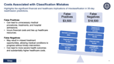
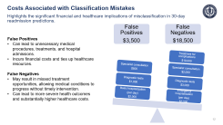
Model Comparison Across Performance Metrics
Key performance metrics evaluated across different models and neural network was chosen for its effective reduction of false negatives, enhancement of true positives and sensitivity.
Minimizing false negatives is crucial in our business problem to avoid incorrectly predicting non-readmission for patients who will indeed require readmission.
Notes:
To compare all the models that we have run, we decided to create a table including the confusion matrix and different measures of accuracy across all models. We also calculated cost for each model which was explained in previous slides. Further, we created a heat map to display the effectiveness of all the models across different measures of accuracy. For our business case we are more concerned with reducing the number of false negatives and increasing sensitivity because we want to minimize the number of instances where we are telling a patient that they will not be readmitted when they actually will be. False negatives in our case could mean cost of life or huge medical expenses in future. This is why low model cost is also very important to us. Considering all the factors discussed so far, we decided to look for models with least costs out of all the 5 remaining models, because we have already eliminated Naïve Bayes, KNN and Discriminant by looking at the model cost in line chart in previous slides. The least cost is for Logistic, Boosted and Neural and among these three, the overall accuracy, accuracy of 1 and True Negatives are least for Boosted and hence it was eliminated too. Now for the remaining logistic and neural… although cost for logistic is slightly better than neural its sensitivity is significantly worse, and this is why we decided to make this tradeoff where we accept a marginal increase of $100,000 in cost for a significant increase of 5.2% in sensitivity.

Slide 15
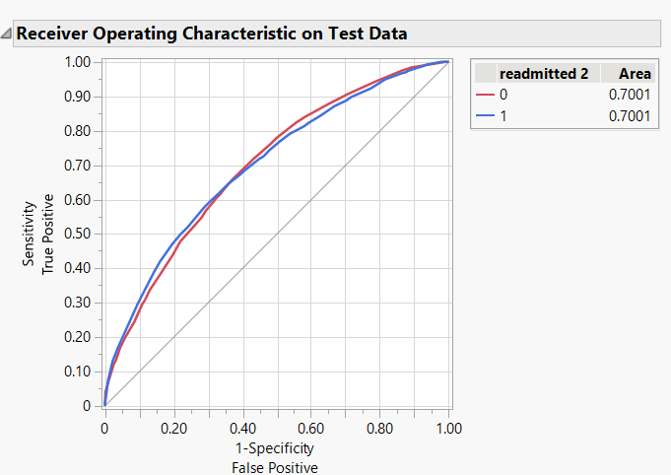
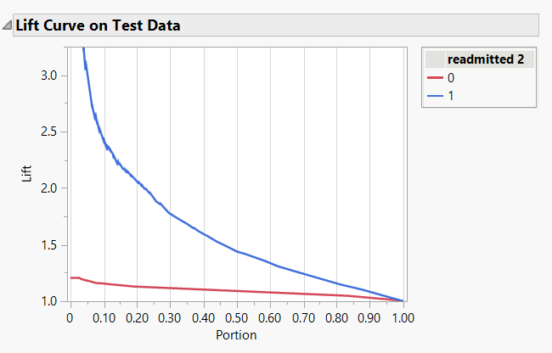
ROC and Lift Curves for Neural Network
The neural network's ROC curve indicates a satisfactory balance between sensitivity and specificity, with an AUC of 70 per cent.
ROC
Lift
Conversely, the lift curves are not similar between categories, but significantly better for our area of concern. The lift for readmission is slightly above 2 if we target the top 20% of the population.
ROC is similar for both readmission and non-readmission – a modest ROC of 70%.
Notes:
In this slide we analyze the ROC and Lift Curve for the selected Neural Network. Although the ROC is not great such as the classroom datasets, it is still not too bad with 70% for both 0 & 1. Similarly, Lift is not great either, but if we consider the top 20% of the population for our concerned category that is readmitted within 30 days, the lift is slightly above 2.

Slide 16
Why Neural Network?
Neural network sensitivity outperforms logistic model by 5 per cent.
We measured key performance indicators such as True Positives, False Positives, False Negatives, True Negatives, Accuracy of 1, Sensitivity, Overall Accuracy, and the associated Model Cost.
A comparative analysis of common performance metrics was done on a variety of predictive models. The business problem we are concerned with requires us to have the least number of false negatives because our goal is to reduce the number of instances for recommending someone will not need to be readmitted when they will indeed have to be readmitted.
To address this, we decided to focus on Sensitivity and Accuracy of 1 among all performance metrics. The model cost for each model was also calculated.
While the Neural Network didn't top the charts in accuracy, it emerged as the most cost-effective model, balancing performance with efficiency. Despite the Logistic model's slightly lower cost, its Sensitivity was 5% less than that of the Neural Networks. Hence, we accepted a marginal cost increase for significantly improved sensitivity.
Notes:
This slide is nothing but a written summary of everything we have talked about in the slide with heat map table. Just to re-iterate, we decided to go ahead with neural because of it’s cost effectiveness and ability to reduce number of false negatives while predicting enough true positives.

Slide 17
Experimenting with Cutoffs
Cutoffs were adjusted to find a balance between Sensitivity and Accuracy of 1s, where higher thresholds enhance Accuracy of 1s at the expense of decreased Sensitivity.
Cutoff | 0.4 | 0.45 | 0.5 | 0.6
True Positive (TP) | 1,802 | 1,609 | 1,410 | 951
True Negative (TN) | 5,150 | 6,427 | 7,394 | 9,240
False Positive (FP) | 5,823 | 4,546 | 3,579 | 1,733
False Negative (FN) | 469 | 662 | 861 | 1,320
Accuracy of 1 | 23.63% | 26.14% | 28.26% | 35.43%
Sensitivity | 79.35% | 70.85% | 62.09% | 41.88%
Specificity | 92% | 91% | 90% | 88%
F-Score | 36.42% | 38.19% | 38.84% | 38.39%
Model Cost ($ MM) | $29.06 | $28.16 | $28.46 | $30.49
Choosing 0.45 gives us the best model in terms of cost and very good sensitivity.
Notes:
We also decided to experiment with different cutoffs for our neural network model. The baseline cutoff for our model is 0.5 or 50%. In an effort to increase our sensitivity, we started with a cutoff of 40%. Although sensitivity was almost 80% (an improvement of approximately 20%), the Accuracy of 1 and Model Cost were negatively impacted. We found a “sweet spot” at 45% - where we achieved lowest model cost with a reasonable Accuracy of 1 and Sensitivity. Again, one of our main objectives is to minimize False Negatives – at 662 False Negatives we perform better than the 50% cutoff.

Slide 18
Business Findings
We utilized our model's capabilities for healthcare providers and insurance companies to identify highest risk patients to improve patient care and resource allocations. Furthermore, insurance companies can create risk-adjusted policies.
For Healthcare Providers
Hospitals can use this model to identify the top 20% of patients at highest risk of readmission and allocate more intensive follow-up care, patient education, and support for these individuals.
Hospitals can use the model's predictions to more effectively deploy their resources such as staff time, educational materials, and follow-up care services – which can be more effectively distributed to high-risk patients.
For Insurance Companies
By identifying which patients are at higher risk of readmission, insurance companies can categorize their insured population into different risk tiers. This allows for more accurate pricing of premiums and the creation of risk-adjusted policies.
Insurance companies can create policies that reward hospitals for low readmission rates or provide better coverage for preventative measures – thus influencing hospital practices indirectly.
Notes:
For our business findings, our model can benefit both healthcare providers and insurance companies. Hospitals can identify the top 20% of patients at high-risk of readmission and can provide follow-up care and patient education to reduce their risks of being readmitted. Hospitals can also use this data to aid them in resource management and planning follow-up care services. Alternatively, insurance companies can also identify patients at higher risk of readmission allowing them to more accurately price premiums and create risk-adjusted policies. Insurance companies can also create policies to reward hospitals for lower readmission rates thus incentivizing better hospital care.

Slide 19
Conclusions
Choosing the neural network for medical diagnosis strikes a strategic balance – prioritizing superior diagnostic accuracy in minimizing false negatives and maximizing true positives, while maintaining cost-effectiveness.
The Neural Network is Superior
Because we are predicting a medical diagnosis, the neural network was chosen over the logistic model due to its strengths in minimizing false negatives and maximizing true positives – both important factors in enhancing diagnostic accuracy.
Performance Trade-Off
Despite its slightly lower F-score compared to the logistic model, the neural network’s superiority in effectively managing false negatives and true positives outweighs the marginal decrease in overall F-score.
Cost-Effective Down Selection
The decision to opt for the neural network is supported by a minor difference in cost compared to the logistic model. The superior diagnostic performance of the neural network justifies the investment, aligning with the critical goal of accurate medical predictions while maintaining cost efficiency.
Achieving a Strategic Balance
The selection process demonstrates a strategic balance between maximizing diagnostic accuracy, minimizing potential harm from false negatives, and ensuring cost-effectiveness – thus emphasizing the nuanced considerations in choosing a model for medical diagnosis.
Notes:
In conclusion, we have demonstrated that the neural network is the superior predictive model for our application. Because we are predicting a medical diagnosis, the neural network was selected due to its strength in minimizing false negatives and maximizing true positives. Although its F-score is lower than the logistic model, this was a tradeoff we were willing to make at the benefit of lower False Negatives and higher True Positives. Although the baseline cost of the neural network was higher than the logistic model, we were able to reduce its cost by tweaking its cutoff thus making it even more attractive. Therefore, we feel that we were able to strike a strategic balance between accuracy and minimizing False Negatives, all while ensuring cost-effectiveness.

Slide 20
Thank You!
Notes:
In conclusion, we have demonstrated that the neural network is the superior predictive model for our application. Because we are predicting a medical diagnosis, the neural network was selected due to its strength in minimizing false negatives and maximizing true positives. Although its F-score is lower than the logistic model, this was a tradeoff we were willing to make at the benefit of lower False Negatives and higher True Positives. Although the baseline cost of the neural network was higher than the logistic model, we were able to reduce its cost by tweaking its cutoff thus making it even more attractive. Therefore, we feel that we were able to strike a strategic balance between accuracy and minimizing False Negatives, all while ensuring cost-effectiveness.

Slide 21
Appendix
Diabetes Care in U.S. Hospitals: Predicting Early Readmission for Better Outcomes

Slide 22
Background Research
We had to take help of Dr Google to understand a lot of variables because data dictionary wasn’t sufficient.
To understand discharge_disposition_id and admission_id we looked up and concluded that each number represents a different case of discharge or admission.
We also created patient journey’s initially to understand the data, since it is not patient specific. Every patient can have multiple instances and hence we decided to understand columns like number_inpatient, number_outpatient, number_emergency to make sure it all adds up.
We also ran several models with different set of variables to understand the impact of each variable on the target.
First model with all the variables
Second model without all the ID columns and missing values columns
Third just with all the drugs and as expected Insulin turned out to be most important.

Slide 23
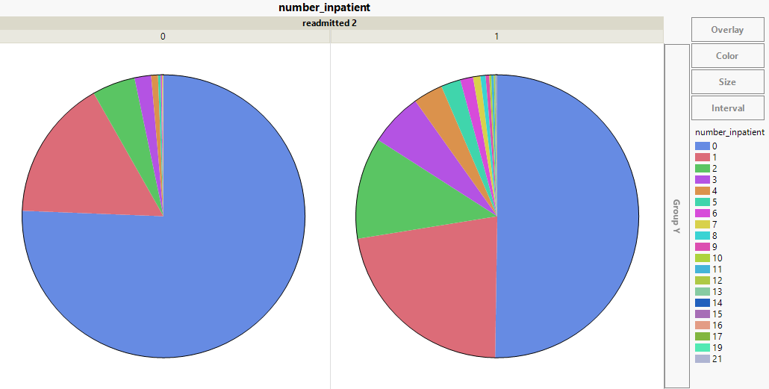
Exploration
“number_inpatient” was found to be the key predictor while exploring the dataset.
This column represents the number of inpatient visits in the year prior to the encounter.
Impact on readmission probability.
If a patient has never been admitted before an instance, then the likelihood of readmission is minimal.
Alternatively, multiple impatient visits correlates with an increased chance of readmission.
A tribute to Newton’s First Law of Physics.
A patient who frequently visits the hospital will tend to revisit.
1 prior admission
No prior admission
No prior admission
1 prior admission
Notes:
We can explain since this is the most important predictor for our target variable we wanted to explore it further and found a direct proportion of pre-admission with readmission. Out of all the patients who were not readmitted 75% of them are first timers and out of all the patients who were readmitted only 50% of them were first timer.

Slide 24
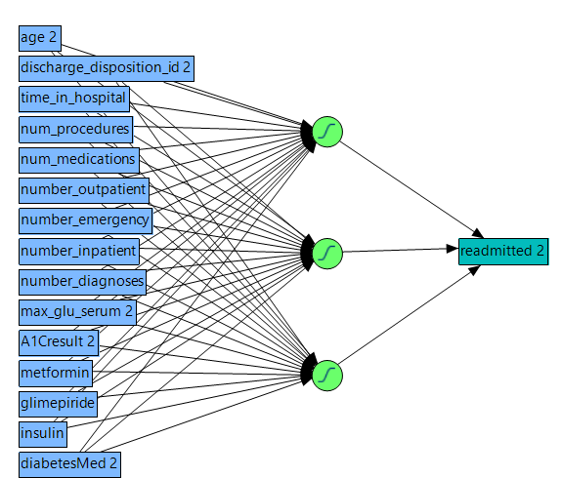
Structure of the Neural Network
Neural Network Diagram
Key Points
Hidden Layer: "1"
Number of Nodes: 3
Type of nodes: TanH
Estimates (Intercept)
Hidden Layer
H1_1: -0.65731
H1_2: -2.89177
H1_3: 1.11347
Output
readmitted 2(0): 1.85481

Slide 25
Neural vs. Logistic
With difference cutoffs
 | Neural |  |  |  | Logistic
Cutoff | 0.4 | 0.45 | 0.5 | 0.6 | 0.6 | 0.4 | 0.45
TP | 1802 | 1609 | 1410 | 951 | 825 | 1803 | 1534
TN | 5150 | 6427 | 7394 | 9240 | 9536 | 5188 | 6804
FP | 5823 | 4546 | 3579 | 1733 | 1437 | 5785 | 4169
FN | 469 | 662 | 861 | 1320 | 1446 | 468 | 737
Accuracy of 1 | 23.63% | 26.14% | 28.26% | 35.43% | 36.47% | 23.76% | 26.90%
Sensitivity | 79.35% | 70.85% | 62.09% | 41.88% | 36.33% | 79.39% | 67.55%
Model Cost | $29.06M | $28.16M | $28.46M | $30.49M | $31.78M | $28.91M | $28.23M
Specificity | 92% | 91% | 90% | 88% | 87% | 92% | 90%
F-Score | 36.42% | 38.19% | 38.84% | 38.39% | 36.40% | 36.58% | 38.48%

Slide 26
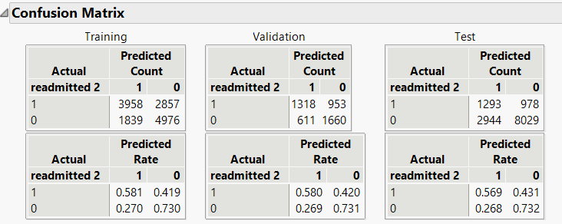
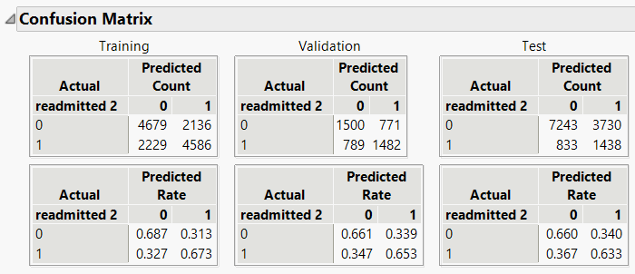
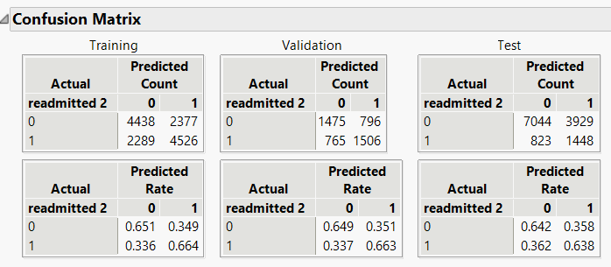
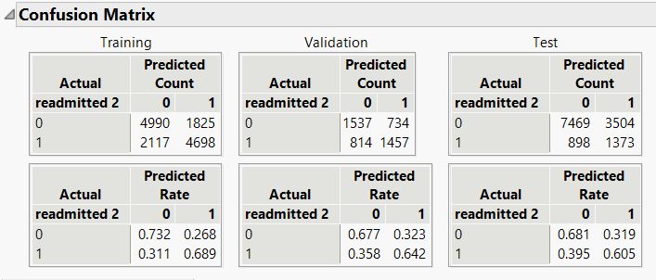
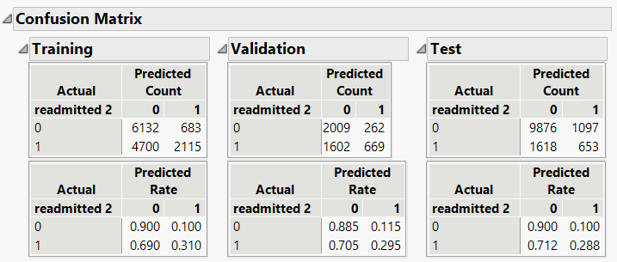
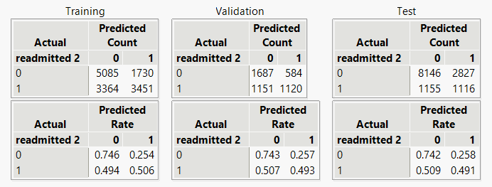
Confusion Matrix for all Models
Logistic
Boosted
Decision Tree
Bootstrap Forest
Naïve Bayes
Discriminant

Slide 27
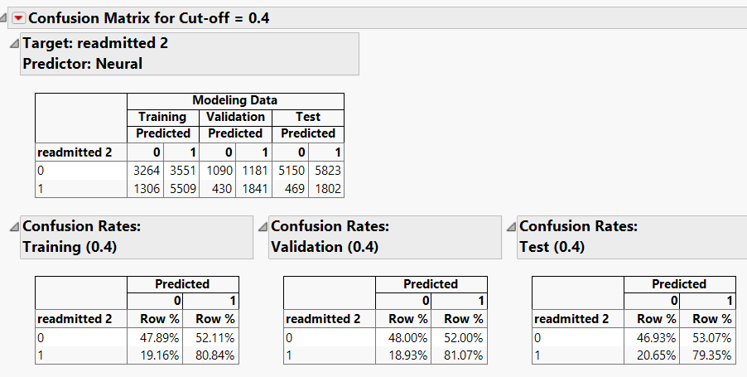
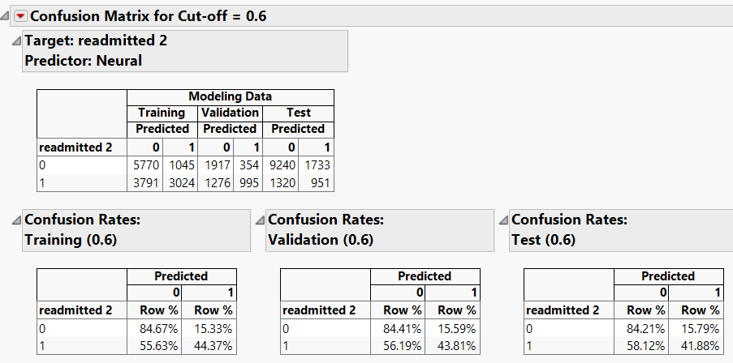
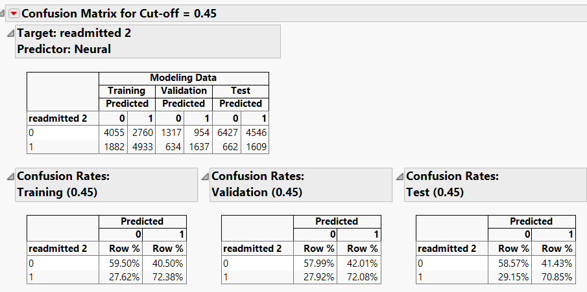
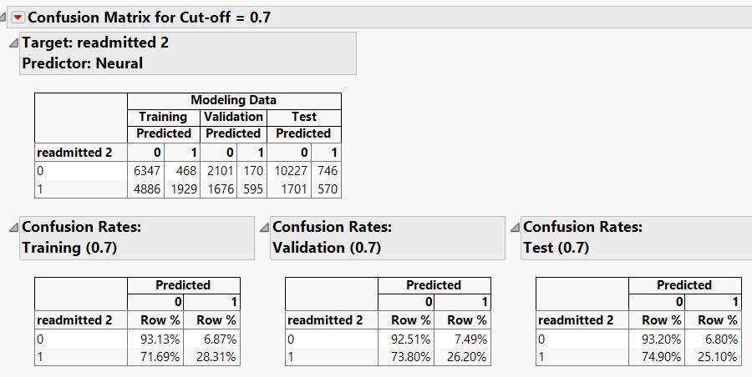
Confusion Matrix of Neural Network for different Cutoffs

Slide 28
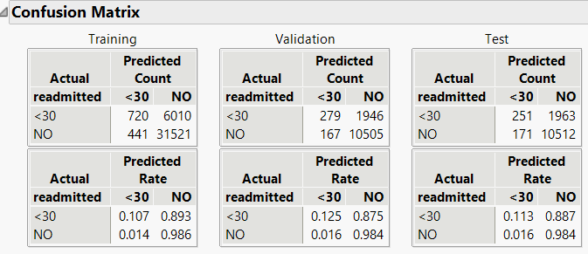
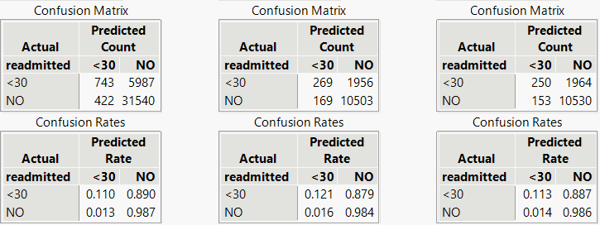
Confusion Matrix of models before oversampling
The prediction of TPs of all the models was bad as the proportion of NO's was extremely high in the dataset which resulted in the prediction of more NO's and we decided to do oversampling to determine the best model
Logistic
Neural

Slide 29
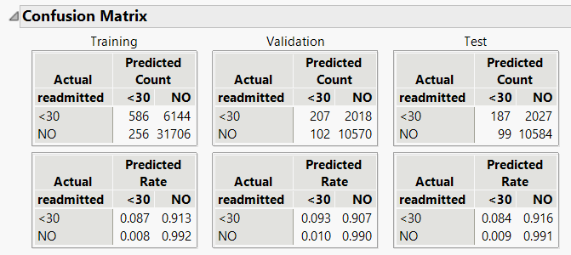
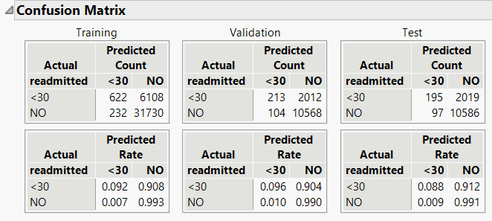
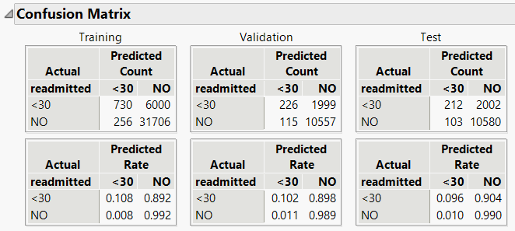
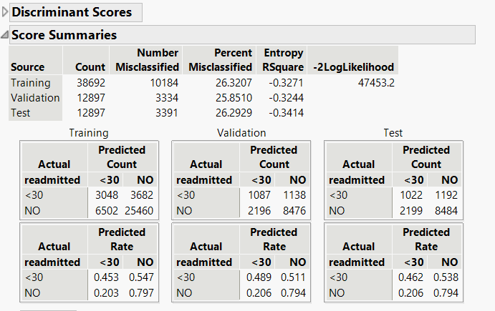
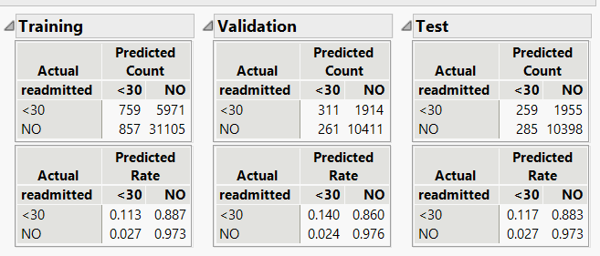
Decision Tree
Bootstrap
Boosted
Discriminant
KNN

Slide 30
End
Diabetes Care in U.S. Hospitals: Predicting Early Readmission for Better Outcomes

